Slide 1
DATA AND SIGNALS

Slide 2
ANALOG AND DIGITAL DATA
Analog Data
Take on continuous values in some interval
E.g. Voice ,Video, data collected by sensors ,such as temperature and pressure.
When someone speaks ,an analog wave is created in the air.
This can be captured by microphone and converted into an analog signal or sampled and converted to a digital signal.

Slide 3
ANALOG AND DIGITAL DATA
Digital Data
Take on discrete values.
E.g. Data stored in computer memory in the form of 0’s and 1’s(text, integers etc.)
Can be converted to a digital signal or modulated into an analog signal.

Slide 4
Analog and Digital Signal
Analog signal
Continuously varying electromagnetic wave that may be propagated over a variety of media, depending upon the spectrum.
It has infinitely many levels of intensity over a period of time.
Media can be guided media such as twisted pair or coaxial cable or unguided media such as atmosphere or space propagation.

Slide 5
Analog and Digital Signal
Digital signal
Sequence of voltage pulses that may be transmitted over a wire medium.
Can have only limited number of defined values.
For e.g., a constant positive voltage represent binary 0 and a constant negative voltage may represent a binary 1.

Slide 6
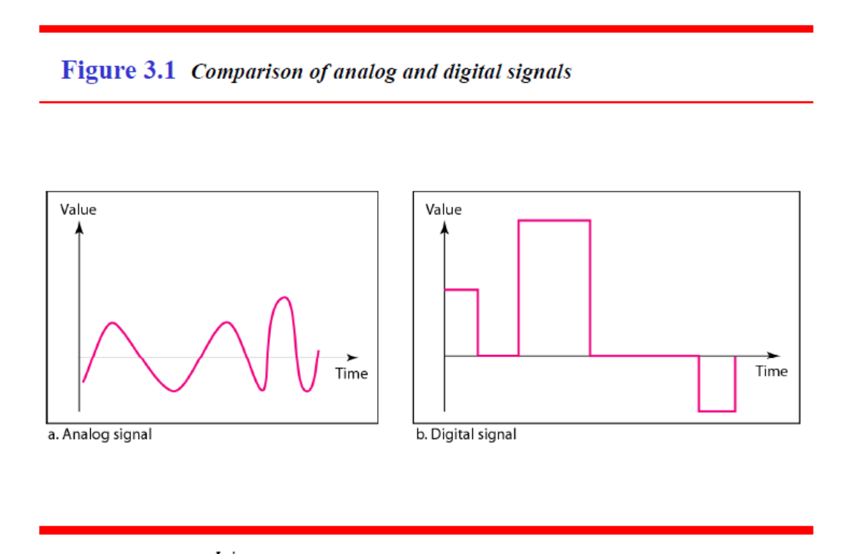
Time Domain Representation
Signals can be plotted on a pair of perpendicular axes.
Vertical axes represents the value or strength of the signal.
Horizontal axes represents the time.

Slide 7
PERIODIC ANALOG AND DIGITAL SIGNALS
Both analog and digital signals can take one of the forms:
Periodic or
Non periodic(Aperiodic)
Periodic signal
Completes a pattern within a measurable time frame, called a period.
Same signal pattern is repeated over subsequent identical periods.
The completion of one full pattern is called a cycle.

Slide 8
PERIODIC ANALOG AND DIGITAL SIGNALS
Non periodic Signal
Changes without exhibiting a pattern or a cycle that repeats over time.
In data communication we commonly use periodic analog signals and non periodic digital signals.

Slide 9
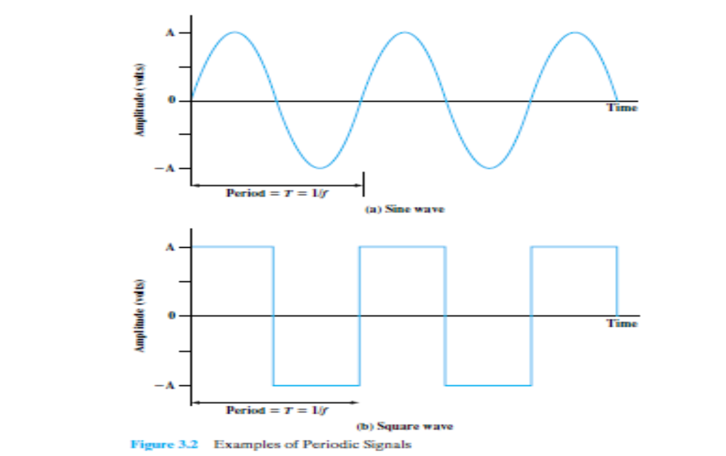
PERIODIC ANALOG AND DIGITAL SIGNALS
Both analog and digital signals can be periodic or non periodic.

Slide 10
PERIODIC ANALOG SIGNALS
Mathematically ,a signal s(t) is defined to be periodic if and only if
s( t +T )=s(t), -∞ < t< +∞
E.g. Sine wave is the fundamental periodic signal

Slide 11
PERIODIC ANALOG SIGNALS
The Sine wave can be represented by three parameters:
Peak Amplitude(A)
Frequency(f)
Phase(Ø)

Slide 12
PERIODIC ANALOG SIGNALS
Peak Amplitude(A)
The maximum value or strength of the signal over time.
It is the absolute value of its highest intensity ,proportional to the energy it carries.
For electrical signals, peak amplitude is normally measured in volts.

Slide 13
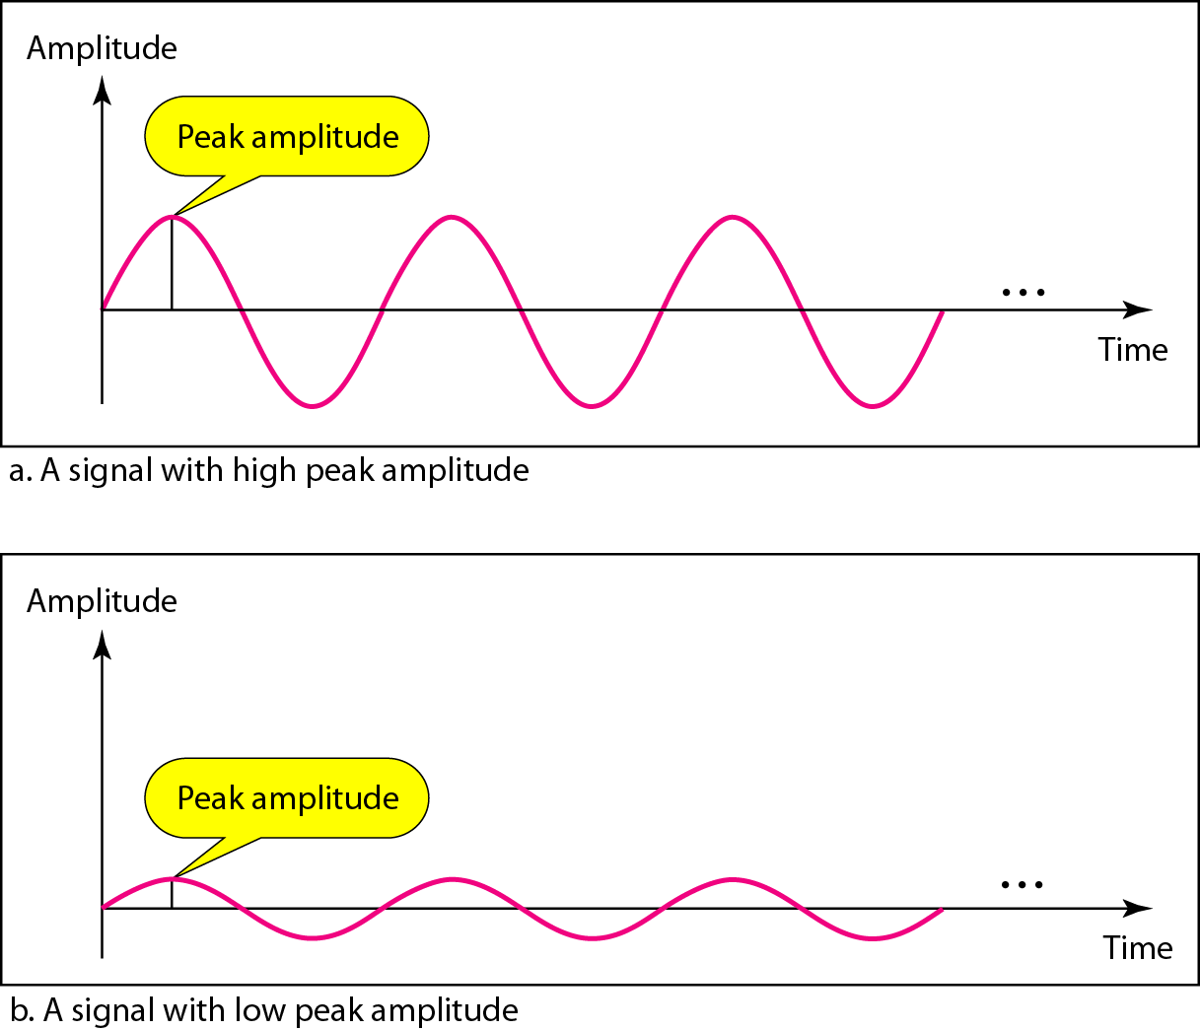
Signal amplitude

Slide 14
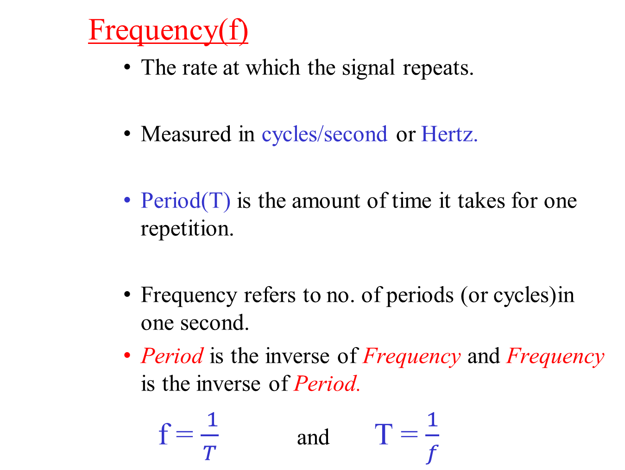
PERIODIC ANALOG SIGNALS
Frequency(f)
The rate at which the signal repeats.
Measured in cycles/second or Hertz.
Period(T) is the amount of time it takes for one repetition.
Frequency refers to no. of periods (or cycles)in one second.
Period is the inverse of Frequency and Frequency is the inverse of Period.
f = $\frac{ 1}{T}$ and T = $\frac{1}{f}$

Slide 15
PERIODIC ANALOG SIGNALS
Frequency is the rate of change with respect to time.
Change in a short span of time means high frequency.
Change over a long span of time means low frequency.
If a signal does not change at all, its frequency is zero
If a signal changes instantaneously, its frequency is infinite.
Notes:
15

Slide 16

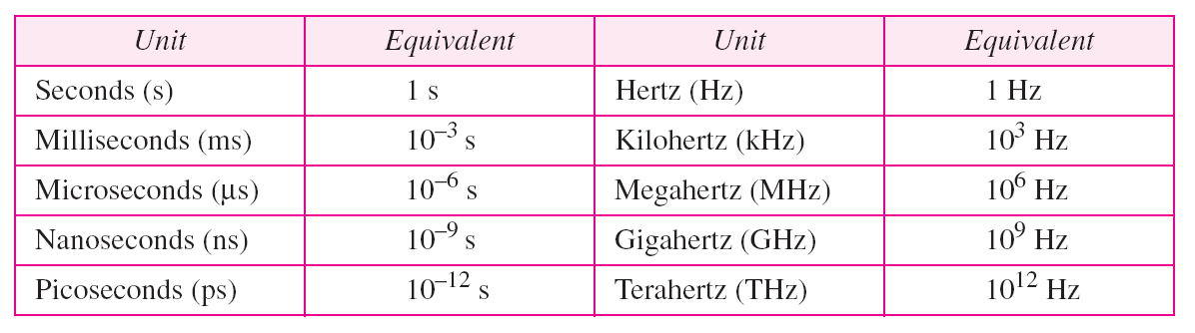
Frequency and Period
Frequency and period are the inverse of each other.
Units of period and frequency
Notes:
16

Slide 17
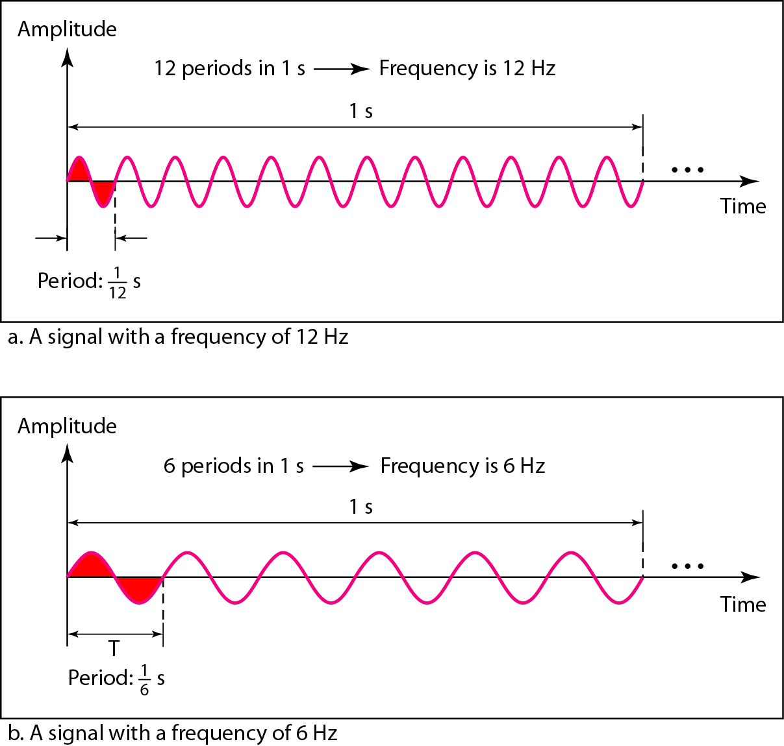
Two signals with the same amplitude, but different frequencies

Slide 18
Examples
1.The power we use at home has a frequency of 60 Hz. What is the period of this sine wave ?
2.The period of a signal is 100 ms. What is its frequency in kilohertz?
Notes:
18

Slide 19
PERIODIC ANALOG SIGNALS
Phase(Ø)
Phase is the position of the wave relative to time 0.
i.e. For a periodic signal f(t),phase is the fractional part t/T of the period T through which t has advanced relative to an arbitrary origin.
The origin is taken as the last previous passage through zero from the negative to the positive direction.

Slide 20
PERIODIC ANALOG SIGNALS
The general sine wave can be written as:
S(t)=A sin(2∏f t+Ø)
This function is known as sinusoid.

Slide 21
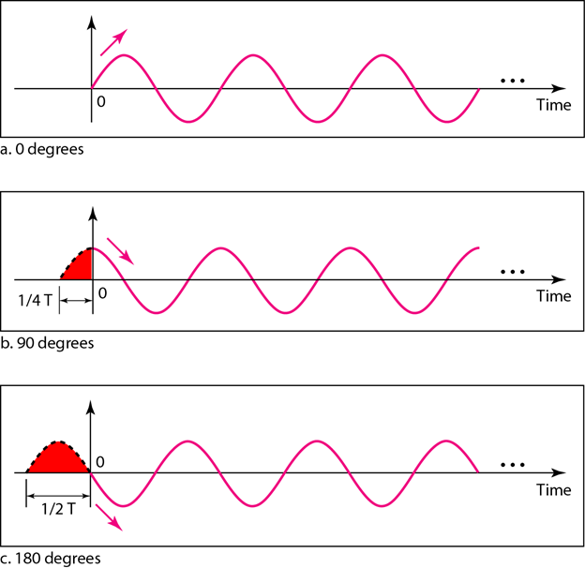
PERIODIC ANALOG SIGNALS
Three sine waves with the same amplitude and frequency, but different phases

Slide 22
PERIODIC ANALOG SIGNALS
A sine wave with phase 0° starts at time 0 with zero amplitude. The amplitude is increasing.
A sine wave with a phase of 90° starts at time 0 with a peak amplitude. The amplitude is decreasing.
A sine wave with phase of 180° starts at time 0 with a zero amplitude .The amplitude is decreasing.

Slide 23
PERIODIC ANALOG SIGNALS
Phase in terms of shift or offset:
A sine wave with a phase of 0° is not shifted.
A sine wave with a phase of 90° is shifted to the left by ¼ cycle.
A sine wave with a phase of 180° is shifted to the left by ½ cycle.

Slide 24
Signals with different parameters

Slide 25
Example
A sine wave is offset 1/6 cycle with respect to time 0. What is its phase in degrees and radians?
Solution
We know that 1 complete cycle is 360°. Therefore, 1/6 cycle is
Notes:
25

Slide 26
PERIODIC ANALOG SIGNALS
Wavelength(λ)
Wavelength is a characteristic of a signal travelling through a transmission medium.
It is the distance a simple signal can travel in one period.
It binds the period or the frequency of a simple sine wave to the propagation speed of the medium.

Slide 27
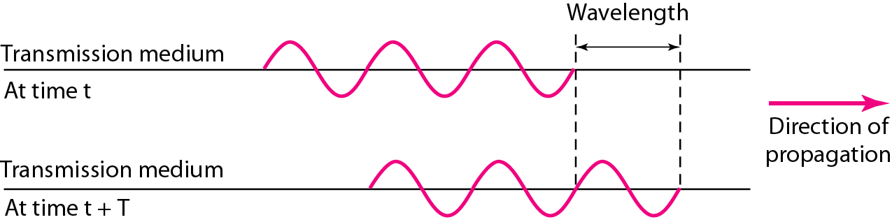

Wavelength and period

Slide 28
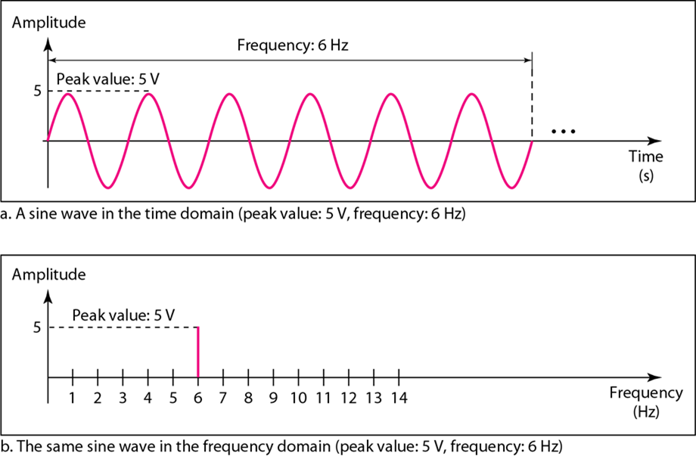
Frequency Domain Representation
Shows the relationship between amplitude and frequencies in a signal.
A complete sine wave in the time domain can be represented by one single spike in the frequency domain.

Slide 29
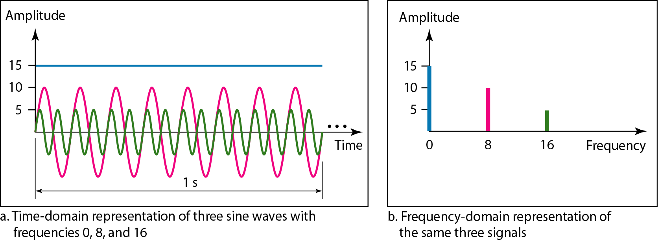
Frequency Domain Representation
The frequency domain is more compact and useful when we are dealing with more than one sine wave.
A single-frequency sine wave is not useful in data communication
We need to send a composite signal, a signal made of many simple sine waves.

Slide 30
Simple or Composite signal
Periodic signals can be classified as simple or composite.
A simple periodic signal, a sine wave cannot be decomposed into simpler signals.
A composite periodic analog signal is composed of multiple sine waves which may have different amplitude ,frequency or phase.
In practice, the electromagnetic signal will be made up of many frequencies.

Slide 31
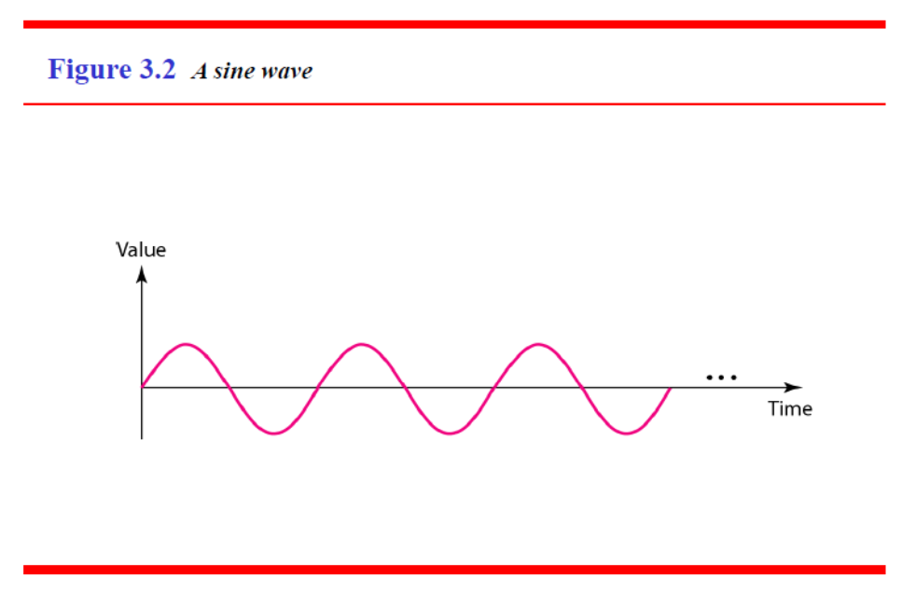
Simple signal
Application: we can send a single sine wave to carry electric energy from one place to another; here the sine wave is carrying energy
We can send a single sine wave to send a alarm to a security center when a burglar opens a door in a house; here the sine wave is a signal of danger

Slide 32
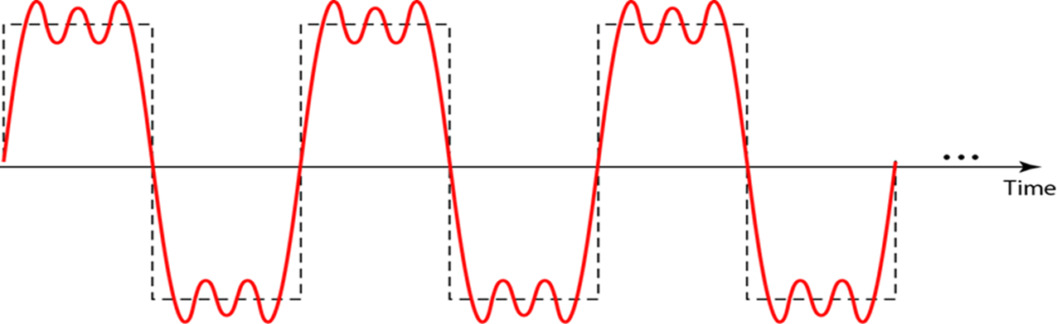
A composite periodic signal
Three alarm system

Slide 33
Fourier analysis
According to Fourier analysis,
any composite signal is a combination of simple sine waves with different frequencies, amplitudes, and phases.
If the composite signal is periodic, the decomposition gives a series of signals with discrete frequencies;
If the composite signal is non periodic, the decomposition gives a combination of sine waves with continuous frequencies.
Notes:
33

Slide 34
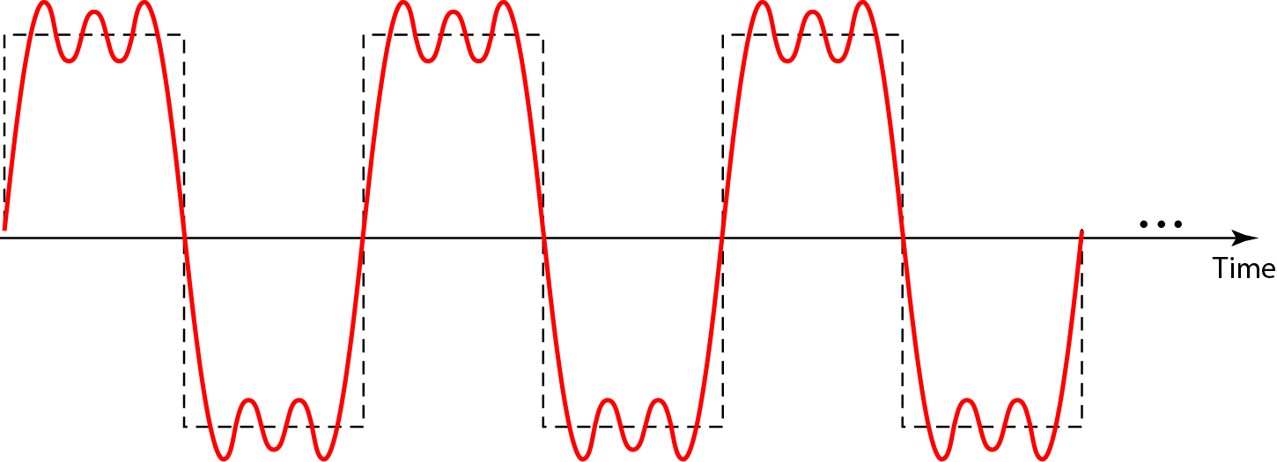
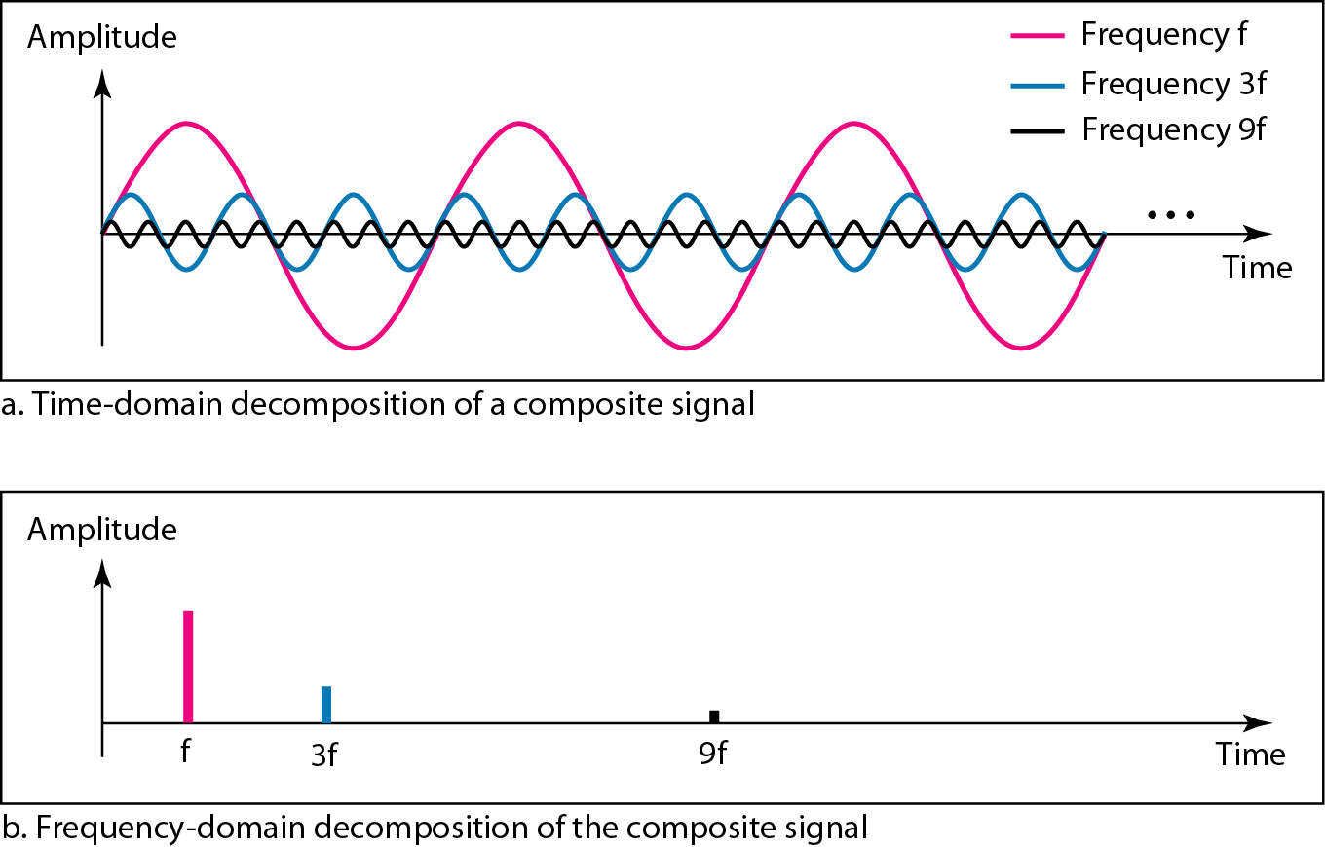
Decomposition of composite periodic signal
Decomposition of the composite periodic signal in the time and frequency domains

Slide 35
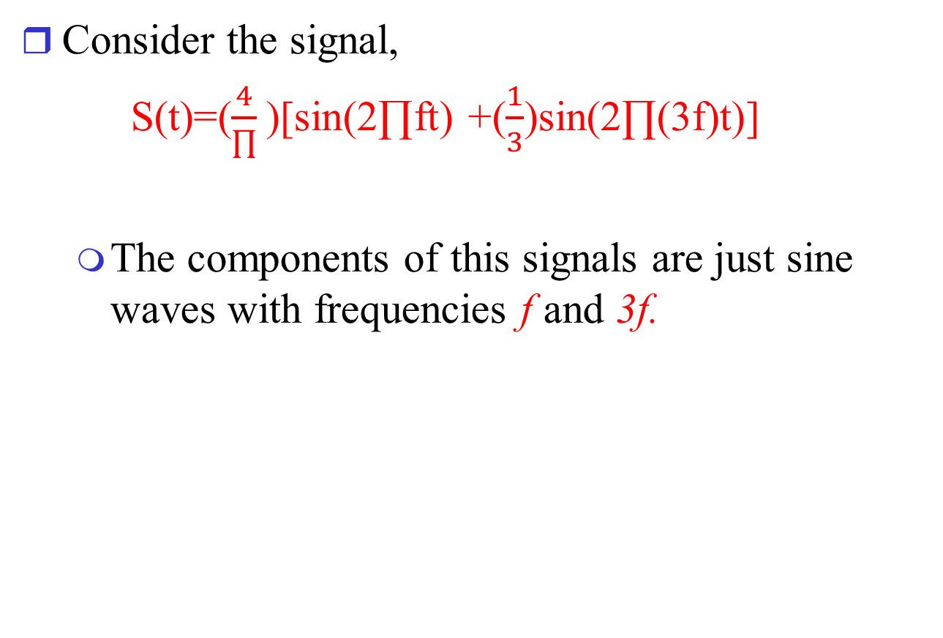
A composite periodic signal
Consider the signal,
S(t)=($\frac{4}{∏}$)[sin(2∏ft) +($\frac{1}{3}$)sin(2∏(3f)t)]
The components of this signals are just sine waves with frequencies f and 3f.

Slide 36
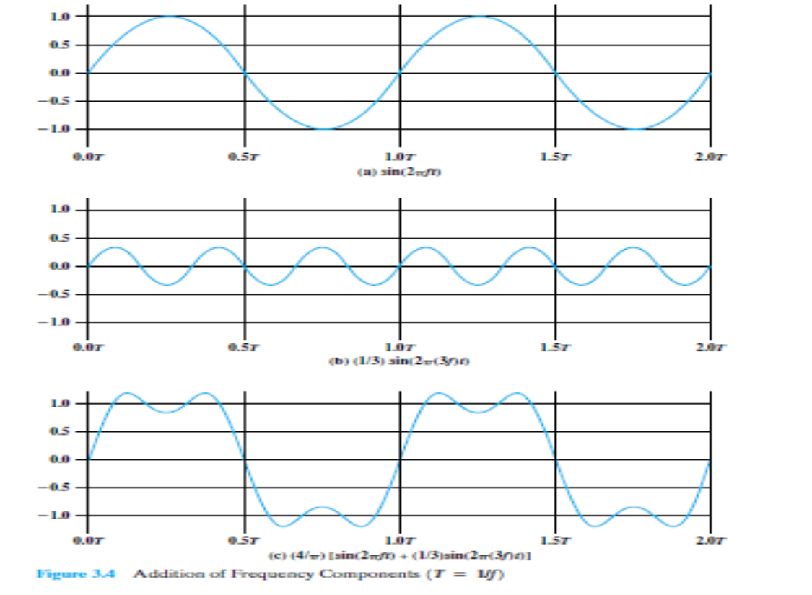
A composite periodic signal

Slide 37
Frequency domain representation

Slide 38
A composite periodic signal
Fundamental frequency
When all the frequency components of a signal are integral multiples of one frequency, the latter frequency is called fundamental frequency or first harmonic .
In the above e.g. f is the fundamental frequency.
3f is the third harmonic.
The period of the total signal is equal to the period of the fundamental frequency.
i.e. the period of the component sin(2∏ft) is T=1/f; and the period of the signal s(t) is also T.

Slide 39
Non periodic composite signal
A non periodic composite signal
It can be a signal created by a microphone or a telephone set when a word or two is pronounced.
In this case, the composite signal cannot be periodic
because that implies that we are repeating the same word or words with exactly the same tone.
A normal human being can create a continuous range of frequencies between 0 and 4kHz.

Slide 40
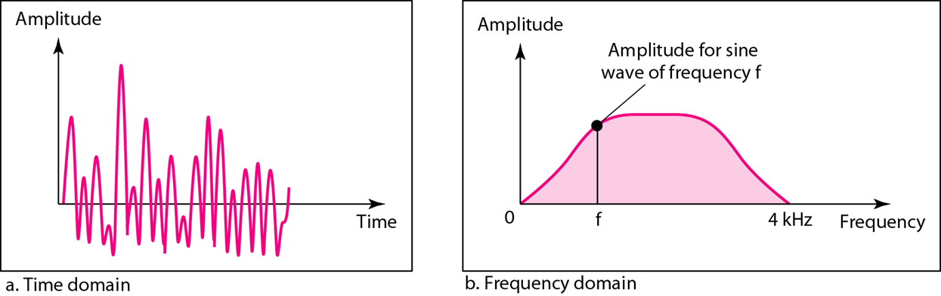
Time and frequency domains of a non periodic signal

Slide 41
Bandwidth
The range of frequencies contained in a composite signal is its spectrum.
The absolute bandwidth of a composite signal is the difference between the highest and the lowest frequencies contained in that signal.
For e.g., if a composite signal contains frequencies between 1000 and 5000,its absolute bandwidth is 5000-1000 i.e. 4000

Slide 42
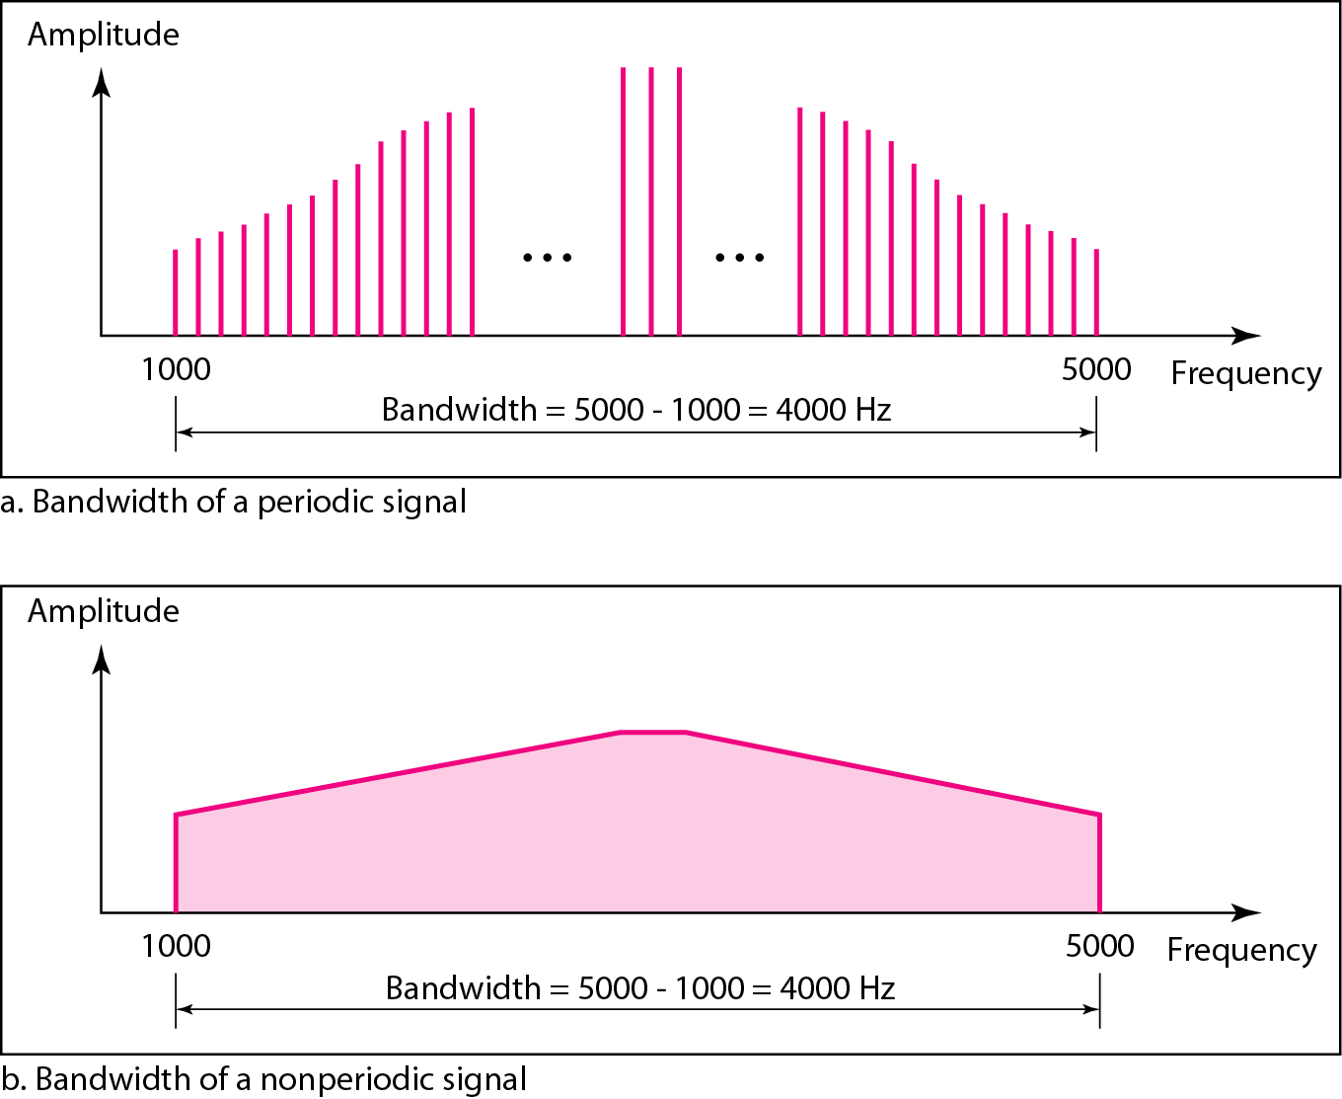
Absolute Bandwidth
The absolute bandwidth of the periodic signal contains all integer frequencies between 1000 and 5000(1000,1001,1002…).
The absolute bandwidth of the non periodic signals has the same range ,but the frequencies are continuous.

Slide 43
Effective bandwidth or bandwidth
Many signals ,such as square wave in fig. has an infinite bandwidth.
However ,most of the energy in the signal is contained in a relatively narrow band of frequencies.
This band is known as the effective bandwidth or just bandwidth.

Slide 44
DC Component
DC Component (dc: direct current)
If the signal include a component of zero frequency (i.e., f = 0),that component is a direct current(dc) or constant component.
With no dc component, a signal has an average amplitude of zero.
With a dc component, a signal has a frequency term at f = 0 and a nonzero average amplitude.

Slide 45
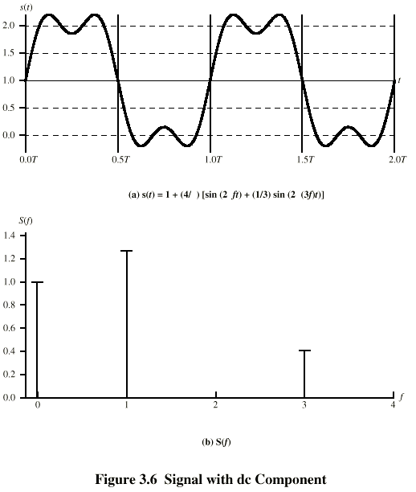
Signal with DC Component
(a) s(t)=1+(4/π)[Sin(2πft)+(1/3)Sin(2π(3f)t)]

Slide 46
Problem-1

Slide 47
Problem-1

Slide 48
Problem-2

Slide 49
Problem-2

Slide 50
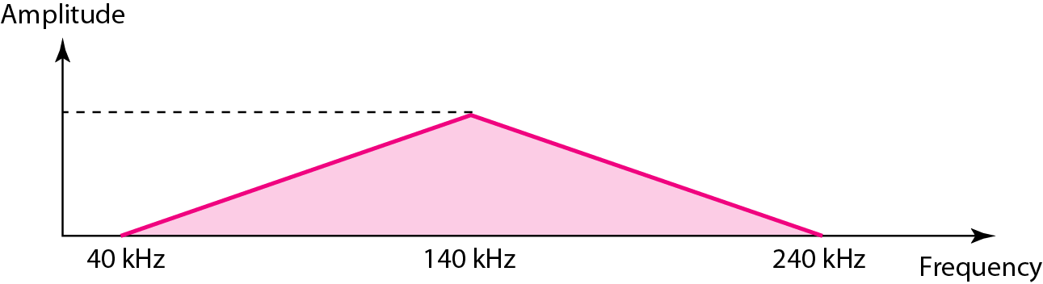
Problem-3
A non periodic composite signal has a bandwidth of 200 kHz, with a middle frequency of 140 kHz and peak amplitude of 20 V. The two extreme frequencies have an amplitude of 0. Approximately, draw the frequency domain of the signal.
Solution
The lowest frequency must be at 40 kHz and the highest at 240 kHz.
Notes:
50

Slide 51
Digital Signal
Information can also be represented by a digital signal.
For example, a 1 can be encoded as a positive voltage and a 0 as zero voltage.
A digital signal can have more than two levels. In this case, we can send more than 1 bit for each level.

Slide 52
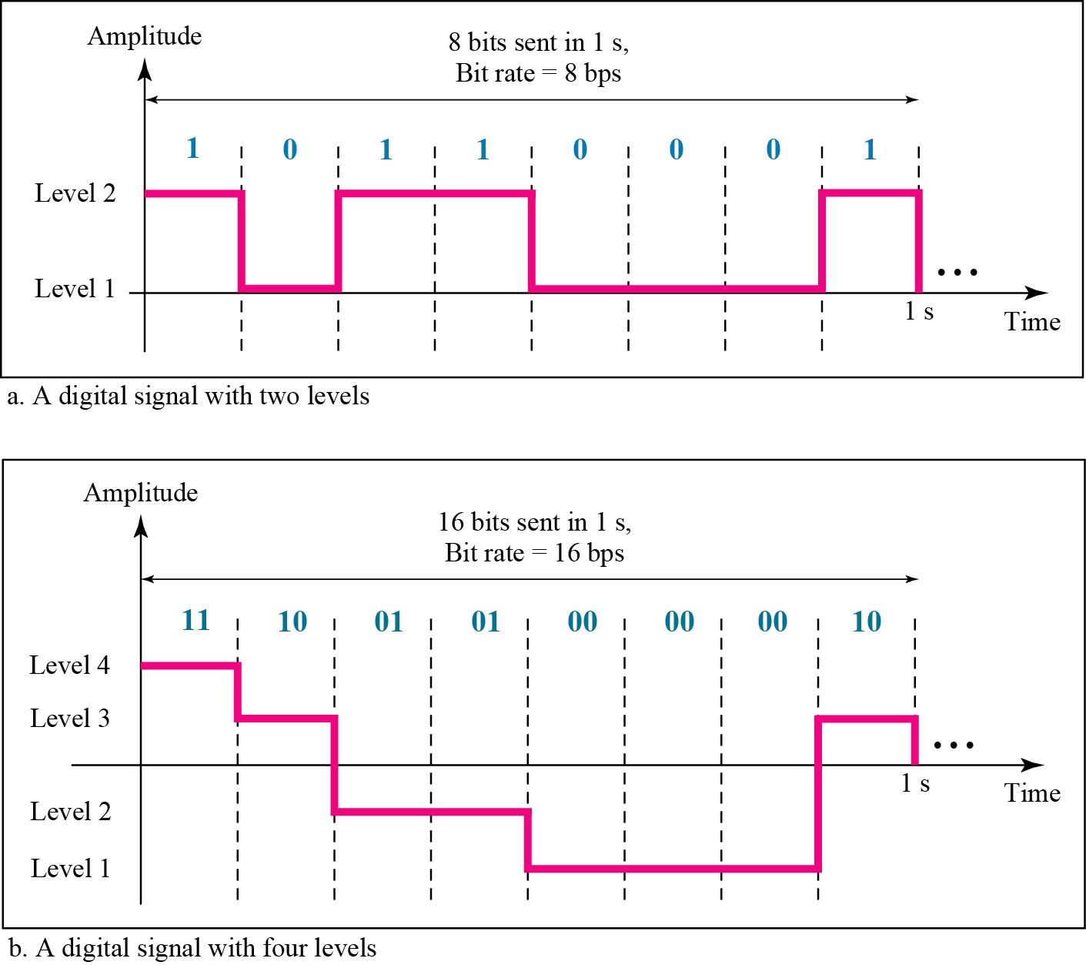
Two digital signals: one with two signal levels and
the other with four signal levels

Slide 53
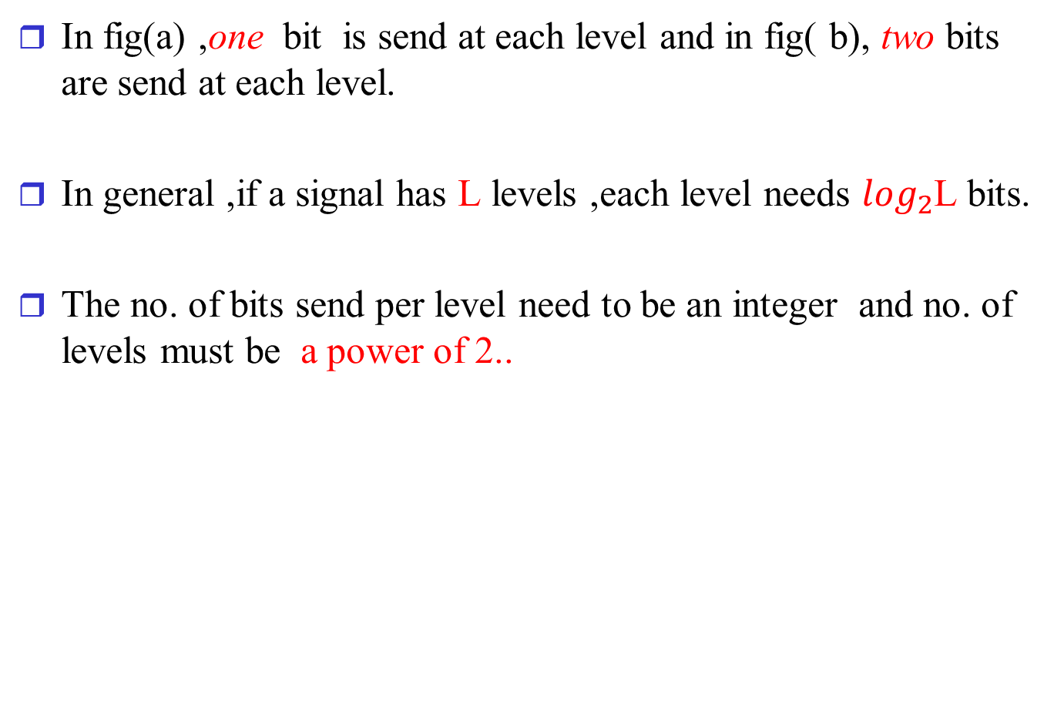
Digital Signal
In fig(a) ,one bit is send at each level and in fig( b), two bits are send at each level.
In general ,if a signal has L levels ,each level needs $\log_{2}$L bits.
The no. of bits send per level need to be an integer and no. of levels must be a power of 2..

Slide 54
Problem

Slide 55
Digital Signal
A digital signal is one in which the signal intensity maintains a constant level for some period of time and then changes to another constant level.
Most digital signals are nonperiodic.
So frequency and period are not appropriate characteristics.
Bit Rate
The number of bits sent in 1 second.
Expressed in bits per second(bps).
Bit Length
The distance one bit occupies on the transmission medium.
Bit length = propagation speed × bit duration

Slide 56
Problem-1
A page is an average of 24 lines with 80 characters in each line. If we assume that each character requires 8-bit ,the bit rate is
Bit rate=(100 ×24×80×8)/60

Slide 57
Problem-2

Slide 58
Problem-3

Slide 59
Digital Signal as a Composite signal
Based on Fourier analysis ,a digital signal is a composite analog signal.
The bandwidth is infinite.
A digital signal in the time domain ,comprises connected vertical and horizontal line segments .
A vertical line in the time domain means a frequency of infinity(sudden change in time)
A horizontal line in the time domain means a frequency of zero(no change in time)
Going from a frequency of zero to a frequency of infinity (and vice versa) implies that all frequencies in between are part of domain

Slide 60
Digital Signal as a Composite signal

Slide 61
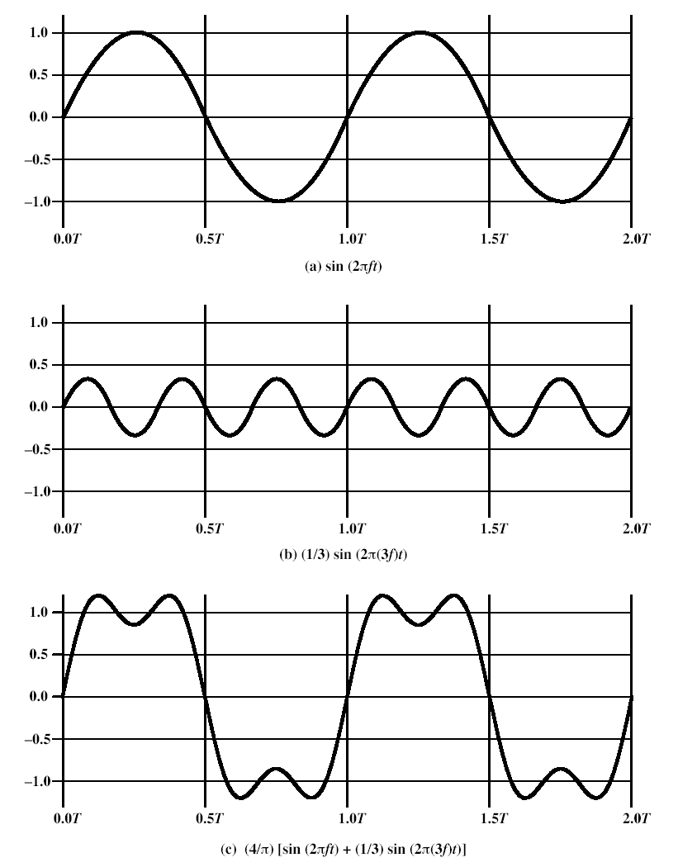
Digital Signal as a Composite Analog Signal
Addition of frequency components T=1/f
This signal has only two frequency components:
(1) frequency f
(2) frequency 3f

Slide 62
Digital signal as a composite analog signal
As we add additional odd multiples of f , suitably scaled ,the resulting wave form approaches that of a square wave more and more closely.
The frequency components of a square wave with amplitude A and –A is given by
This wave form has infinite number of frequency components and thus infinite bandwidth.

Slide 63
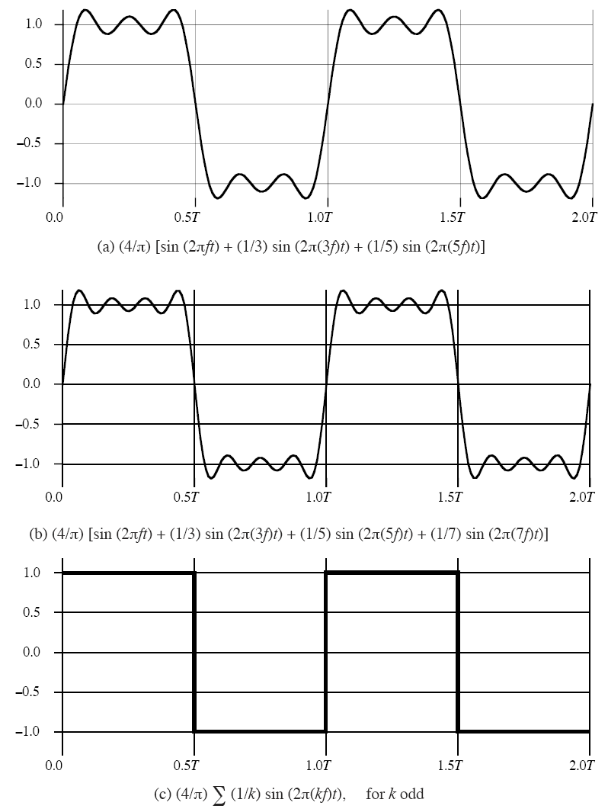
Frequency Components of Square Wave
Bandwidth = 4f
Bandwidth = 6f
Bandwidth = infinity

Slide 64
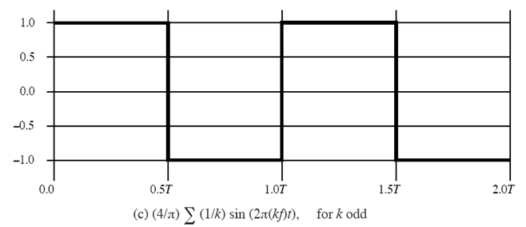
Relationship between Data rate and Bandwidth
Suppose that we are using a digital transmission system that is capable of transmitting signals with a bandwidth of 4MHz
Let us attempt to transmit the sequence of alternating 1’s and 0’s as a square wave given below:

Slide 65
Relationship between Data rate and Bandwidth
CASE I
Approximate square wave with waveform of first three sinusoidal components even though it is a distorted square wave..
s(t)= 4/π[sin(2πf t)+1/3 sin(2π(3f)t)+ 1/5 sin(2π(5f)t)]

Slide 66
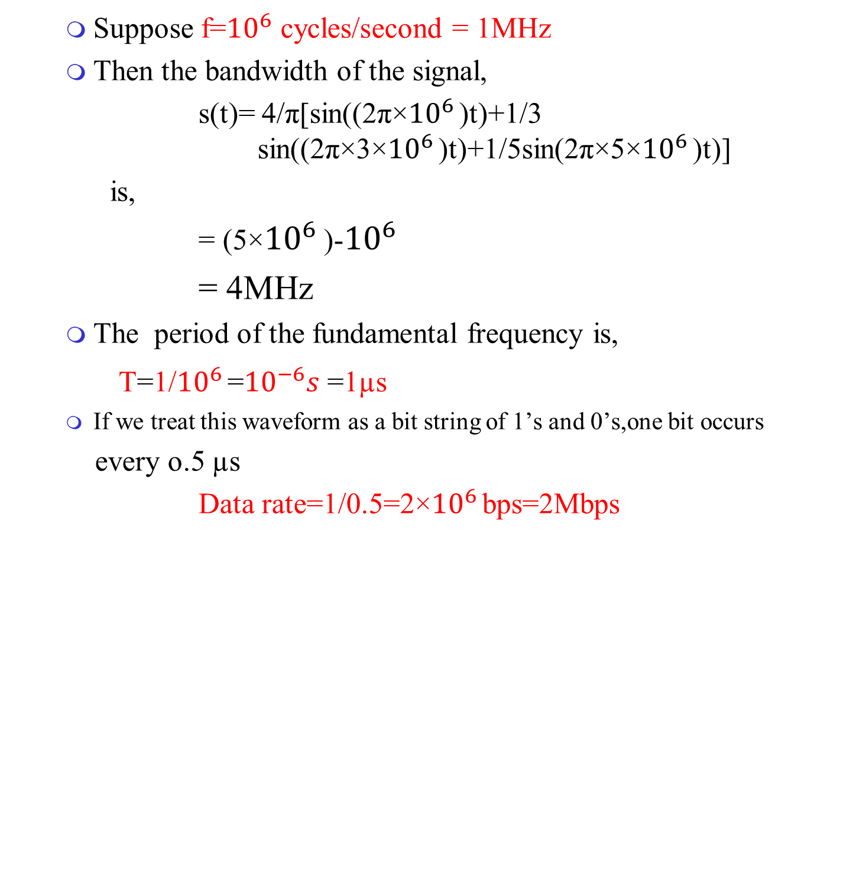
Relationship between Data rate and Bandwidth
Suppose f=${10}^{6}$ cycles/second = 1MHz
Then the bandwidth of the signal,
s(t)= 4/π[sin((2π×${10}^{6 }$)t)+1/3 sin((2π×3×${10}^{6 }$)t)+1/5sin(2π×5×${10}^{6 }$)t)]
is,
= (5×${10}^{6 }$)-${10}^{6 }$
= 4MHz
The period of the fundamental frequency is,
T=1/${10}^{6 }$=${10}^{−6}s$ =1µs
If we treat this waveform as a bit string of 1’s and 0’s,one bit occurs
every o.5 µs
Data rate=1/0.5=2×${10}^{6 }$bps=2Mbps

Slide 67
Relationship between Data rate and Bandwidth
CASE II
Assume bandwidth is 8 MHZ
With f = 2 MHZ = 2 x10⁶ cycles/second
Bandwidth of the signal= 8 MHZ = 5f – f = 4f
For f = 2 MHZ, period of fundamental frequency
T=1/(2 x10⁶)= 0.5 x10⁻⁶ = 0.5 µs
One bit occurs every 0.25 µs
Data rate =1/0.25 =4 x 10⁶ bps or 4 Mbps
Bandwidth = 4 MHZ Data Rate = 2 Mbps
Bandwidth = 8 MHZ Data Rate = 4 Mbps

Slide 68
Relationship between Data rate and Bandwidth
CASE III
Approximate square wave with waveform of first two sinusoidal components
s(t)= 4/π[sin(2πf t)+1/3 sin(2π(3f)t) ]

Slide 69
Relationship between Data rate and Bandwidth
Assume we have a bandwidth = 4 MHZ
With f= 2 MHZ =2 x 10⁶ cycles/second;
period T= 0.5 µs
Bandwidth of the signal = 3f – f = 2f
=2× 2 x 10⁶
=4MHz
One bit occurs every 0.25 us
Data rate is 4 x 10⁶ bps or 4 Mbps
Bandwidth = 4 MHz Data Rate = 4 Mbps
A given bandwidth can support various data rates depending on ability of receiver to distinguish 0 & 1

Slide 70
Relationship between Data rate and Bandwidth
CASE I: Bandwidth=4MHz; Data rate=2Mbps
CASE II: Bandwidth=8MHz; Data rate=4Mbps
CASE III: Bandwidth=4MHz; Data rate=4Mbps

Slide 71
Relationship between Data rate and Bandwidth
Conclusion
Any digital waveform will have infinite bandwidth.
Transmission system will limit the bandwidth of the signal that can be transmitted.
For any given medium ,the greater the bandwidth transmitted ,the greater the cost.
So digital information should be approximated by a signal of limited bandwidth.
But limiting bandwidth will create distortions ,which makes the task of interpreting the received signal more difficult.

Slide 72
Effect of Bandwidth on Digital signal
Fig. shows a digital bit stream with a data rate of 2000 bits per second.

Slide 73
Effect of Bandwidth on Digital signal
In general, if the data rate of the digital signal is
W bps,then a very good representation can be achieved with a bandwidth of 2W Hz
If noise is less, it can be achieved with a less bandwidth also.
i.e. higher the data rate of a signal, the greater is its required effective bandwidth.
Or the greater bandwidth of the transmission system ,the higher is the data rate that can be transmitted over that system.

Slide 74
Effect of Bandwidth on Digital signal
Center frequency:
The frequency at which the bandwidth of the signal is centered.
Higher the center frequency, higher the potential bandwidth and therefore the higher the potential data rate.
For e.g. if the signal is centered at 2MHz,its maximum potential bandwidth is 4MHz.

Slide 75
Analog and Digital signaling of Analog and Digital data
Analog signaling
Data can be encoded into signals in a variety of ways

Slide 76
Analog and Digital signaling of Analog and Digital data
Digital signaling

Slide 77
Analog and Digital Transmission
Analog Transmission
Is a means of transmitting analog signals without regard to their content.
Signals may represent analog data(voice) or digital data(binary data that pass through a modem)
In either case, the signal will attenuate after a certain distance.
Amplifiers are added to boost the energy of the signals, but it boosts the noise components also.
Cascading of amplifiers cause distortion in the signal.
Analog data will tolerate distortion to some extent, but digital data causes errors.

Slide 78
Analog and Digital Transmission
Digital Transmission
Assumes binary content of the signal.
Digital signals can be transmitted only to a limited distance.
Get affected by attenuation ,noise etc.
Repeaters are used ,which receives 1’s and 0’s in the signal and retransmits a new signal.
Thus attenuation is overcome.

Slide 79
Analog and Digital Transmission
Digital Transmission
Repeaters can also be used instead of amplifiers ,if the analog signal is assumed to carry digital data.
The repeaters will recover the digital data from analog signal and generates a new ,clean analog signal.
Digital transmission is considered to better than analog transmission for various reasons.

Slide 80
Methods of Data Transmission

Slide 81
Treatment of signals

Slide 82
Digital Transmission
Advantages
Digital Technology
The advent of large scale integration (LSI ) and very-large scale integration (VLSI) technology has caused a continuing drop in cost and size of digital circuitry.
Data Integrity
With the use of repeaters rather than amplifiers, the effects of noise and other signal impairments are not cumulative.
Thus it is possible to transmit data longer distances and over lower quality lines by digital means while maintaining the integrity of the data.

Slide 83
Digital Transmission
Capacity Utilization
It is more economical to build transmission links of high bandwidth ,including satellite channels and optical fiber.
A high degree of multiplexing is needed to utilize such capacity effectively.
This is achieved more easily and cheaply with digital(time division) rather than analog( frequency division)
Security and Privacy
Encryption techniques can be readily applied to digital data and to analog data that have been digitized.

Slide 84
Digital Transmission
Integration
By treating both analog and digital data digitally, all signals have the same form and can be treated similarly.
Economies of scale and convenience can be achieved by integrating voice ,video and digital data.

